Slide 1
Aerospace-Predictive-Maintenance

Slide 2
Objective:
Development of a predictive model for Calculating Remaining Useful Life (RUL) for Aerospace Engine . The model will determine whether the Engine can is okay for more flights or not and the RUL.
Benefits:
Engine failure prevention.
.
Helps in Maintenance Cycle .
Human Life Safty .

Slide 3
Data Sharing Agreement :
The data are provided as a zip-compressed text file with 26 columns of numbers, separated by spaces. Each row is a snapshot of data taken during a single operational cycle, each column is a different variable. The columns correspond to:
unit number
time, in cycles
operational setting 1,2 & 3
sensor measurement 1 ,2,3, … ,21
Data Set Organization
Data Set: FD001
Train trjectories: 100
Test trajectories: 100
Conditions: ONE (Sea Level)
Fault Modes: ONE (HPC Degradation)

Slide 4
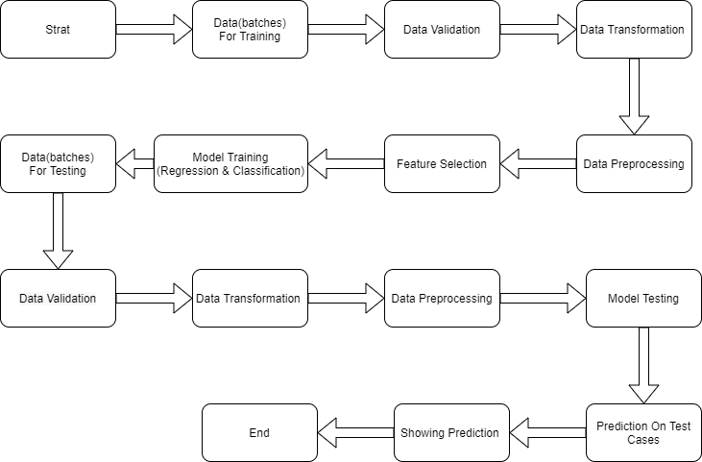
Architecture

Slide 5
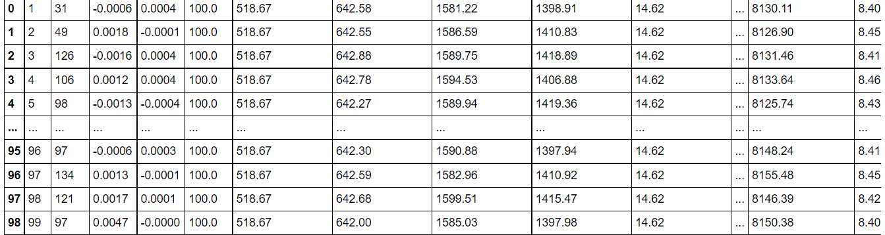
Data Validation and Data Transformation :
Validation :Validation of number of columns and rows
Null Values Removal : Remove the values from the data is any present.

Slide 6
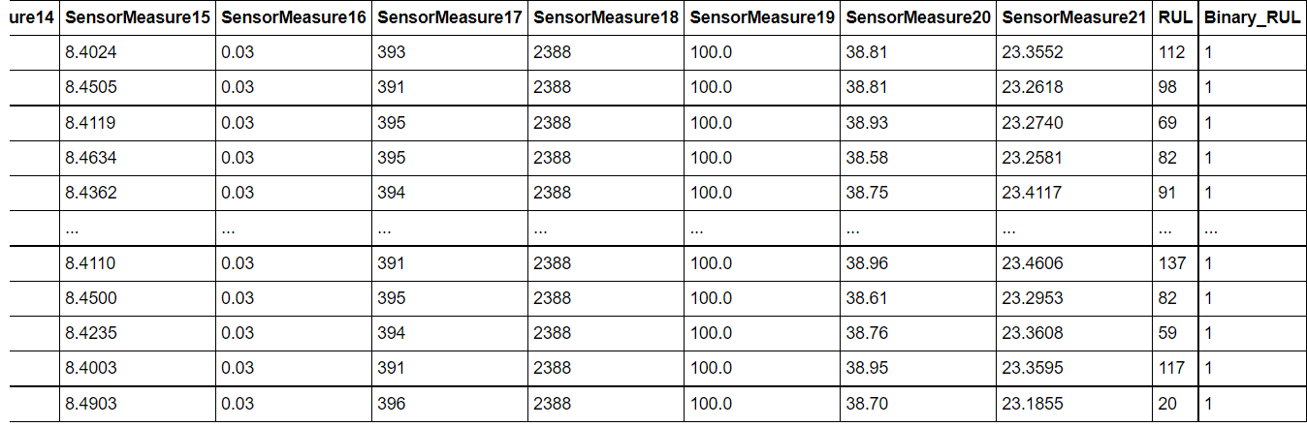
Preprocessing:
Labeling: Labeling columns as per the as given in the schema.
Data Modification: Converting RUL into binary RUL.
Feature Transformation : Scaling Data for Training and Testing.

Slide 7
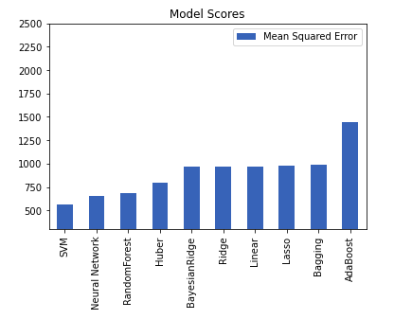
MSE Of Regression Model(For Model Selection):
Regression Models:
SVM
Neural Network
Random Forest
Huber
Bayesian Ridge
Ridge
Linear
Lasso
Bagging
AdaBoost
Mean Squared Error
SVM’s SVR has the lowest MSE. SVR is the best fit model on the train data set.

Slide 8
Model Selection –
After the Mean Squared Error calculated, we find the best Regression model for data is SVM, algorithm Support Vector Regression (SVR) .
Among all the models SVR’s accuracy is the highest.
Support Vector Machine (SVM) is a very popular Machine Learning algorithm that is used in both Regression and Classification. Support Vector Regression is similar to Linear Regression in that the equation of the line is y= wx+b In SVR, this straight line is referred to as hyperplane. The data points on either side of the hyperplane that are closest to the hyperplane are called Support Vectors which is used to plot the boundary line.

Slide 9
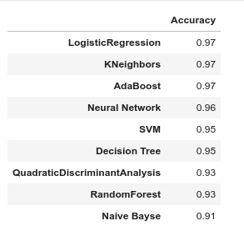
Classification Models :
Used To Prediction Engine Failure in 20 Days
Models:
Logistic Regression
K Neighbors
AdaBoost
Neural Network
SVM
Decision Tree
QuadraticDiscriminantAnalysis
RandomForest
Naive Bayse
Accuracy
Logistic Regression ,K Neighbors and AdaBoost have the highest accuracy. Logistic Regression was used For the prediction of engine failure in 20 days (Binary 1: WILL NOT & 0 : WILL ).

Slide 10
Prediction:
The testing files are shared in the batches and we perform the same Validation operations ,data transformation and data insertion on them.
We perform data pre-processing techniques on it.
The prediction will be on made the key features :
Cycle SensorMeasure12
SensorMeasure2 SensorMeasure13
SensorMeasure3 SensorMeasure14
SensorMeasure4 SensorMeasure15
SensorMeasure7 SensorMeasure17
SensorMeasure8 SensorMeasure20
SensorMeasure9 SensorMeasure21
SensorMeasure11

Slide 11
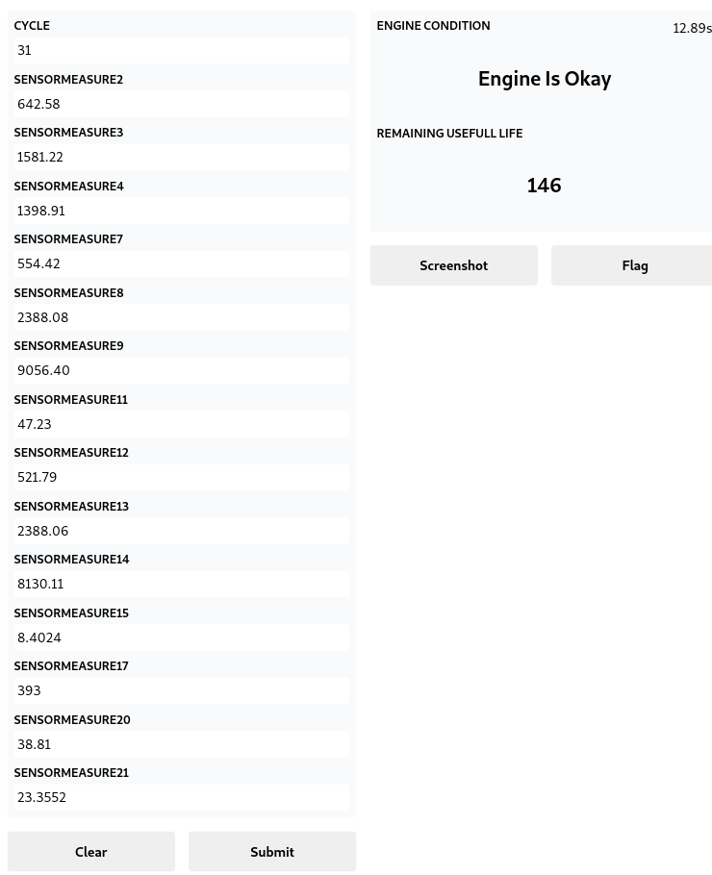
Prediction on a test case
Engine Condition :
Is Okay means it will not fail in 20 or in less the
20 days
Its RUL values is good for more use of the engine.
When the engine’s RUL less than 20 it will be
Consider as in risk state.

Slide 12
Q & A:
Q1) What’s the source of data?
The data for training is from Kaggle. https://www.kaggle.com/behrad3d/nasa-cmaps
Q 2) What was the type of data?
The data was the combination of numerical.
Q 3) What’s the complete flow you followed in this Project?
Refer slide 4th for better Understanding

Slide 13
Q 4) How logs are managed?
We are using different logs as per the steps that we follow in validation and
modeling like File validation log , Data Insertion ,Model Training log , prediction log
etc.
Q5 ) What techniques were you using for data pre-processing?
Removing unwanted attributes
Visualizing relation of independent variables with each other and output variables
Checking and changing Distribution of continuous values
Removing outliers
Cleaning data and imputing if null values are present.
Scaling the data

Slide 14
Q 6) How training was done or what models were used?
Before diving the data in training ,tried to fit many models .
The scaling was performed over training and validation data.
Model which have best MSE and Accuracy were used..
Q 7) How Prediction was done?
The testing files.We Perform the same life cycle till the data is ready to test .. In the end we get the accumulated data of predictions.

